Slide 1
Customer Personality Analysis
Understanding customer behaviour, spending patterns and segmentation
CHEARS Data Analyst Internship · Shrikant Rathod · 11 November 2026

Slide 2
Objective and business questions
Who
What
How much
Who are the customers?
Which product categories drive spending?
How do income and household shape spending?
Which
Segments
Action
Which campaigns and channels perform best?
Can customers be grouped into useful segments?
What should the business test next?
Dataset → Cleaning → EDA → Spending, campaign and channel analysis → K-Means → Recommendations

Slide 3
Dataset and cleaning
2,240
29 → 35
24
0
customer records
columns, original → cleaned
missing Income values, filled with education-group medians
exact duplicate rows
3 invalid birth years (1893, 1899, 1900) set to missing, so Age is missing for 3 customers
Absurd, YOLO and Alone marital labels standardized to Single
8 high-Income outliers flagged and kept, including 666,666
Dt_Customer had mixed formats: 1,324 standardized, 916 ambiguous cells left unresolved
Derived Age, TotalSpending, TotalChildren, TotalPurchases, TotalCampaignsAccepted; removed 2 constant columns

Slide 4
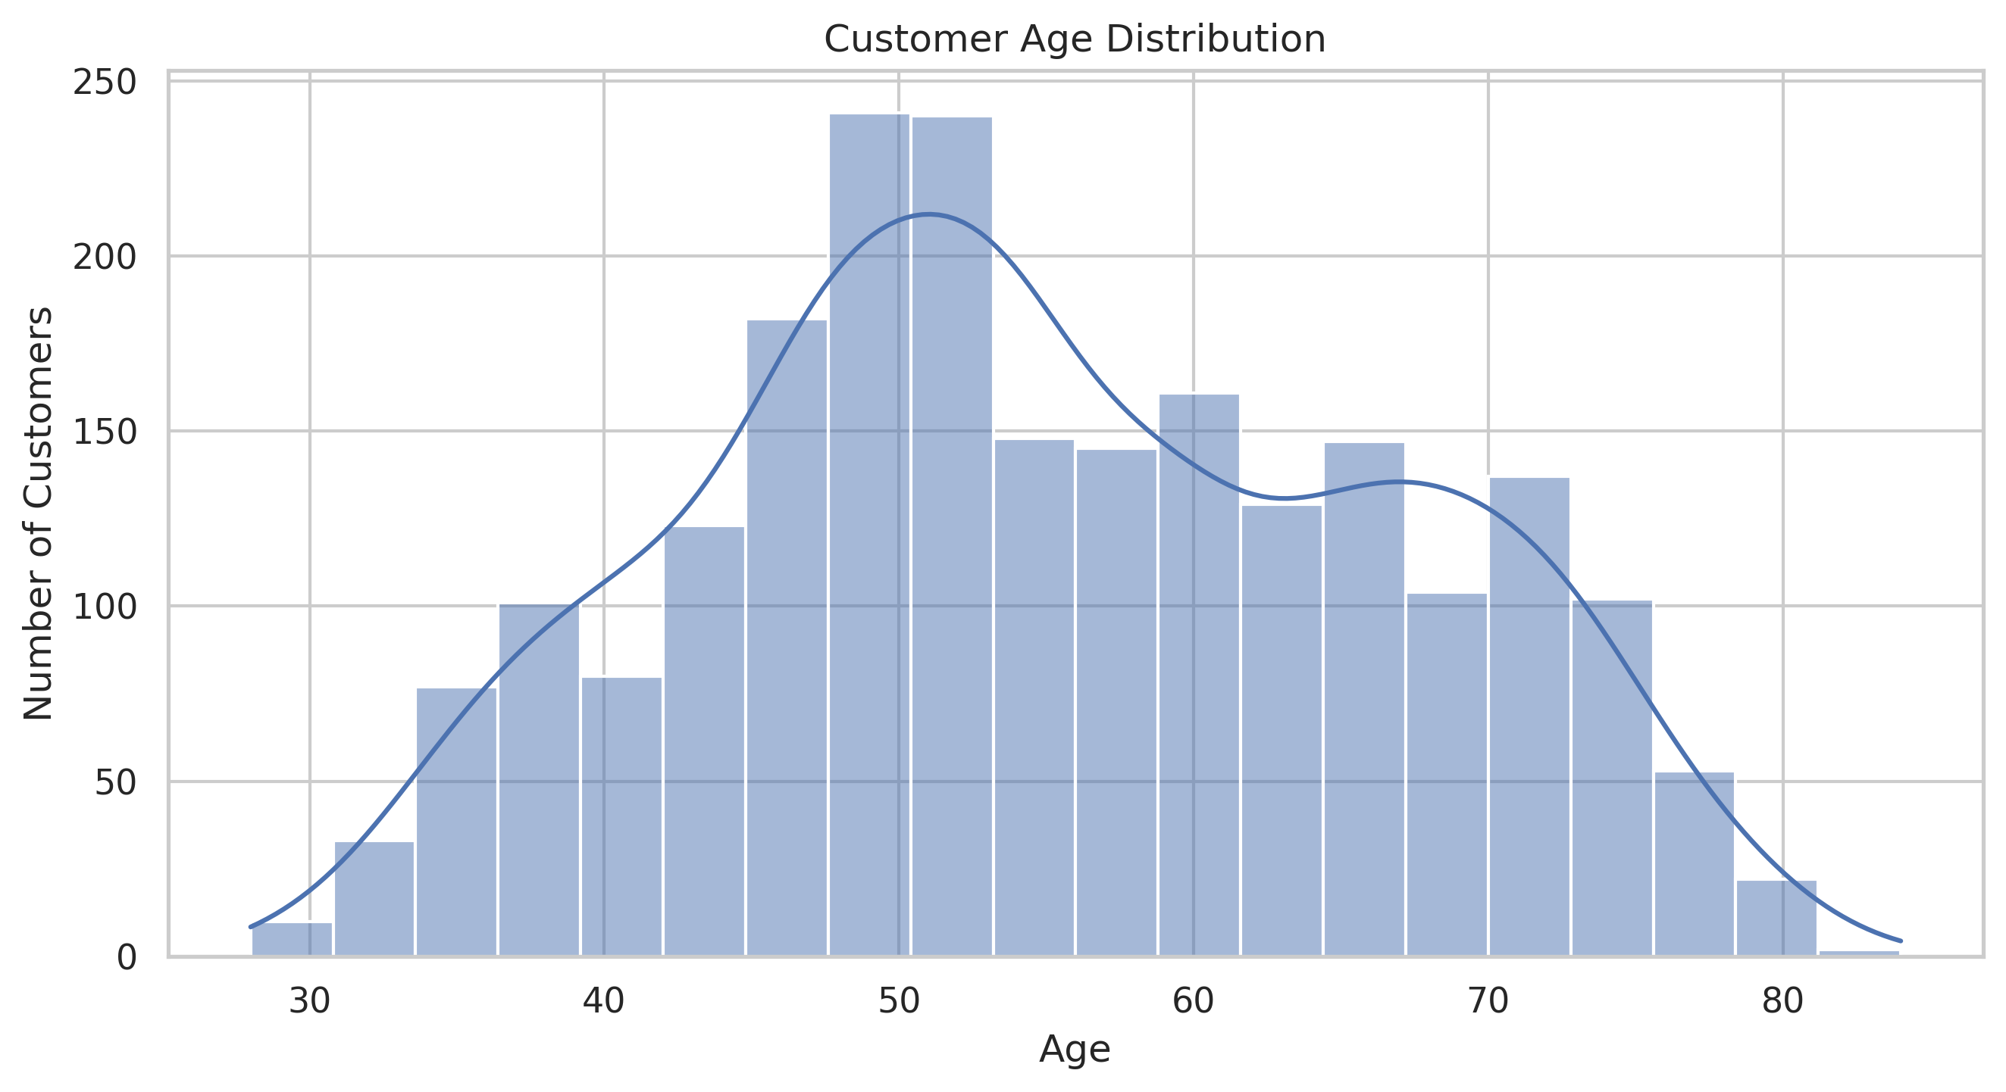
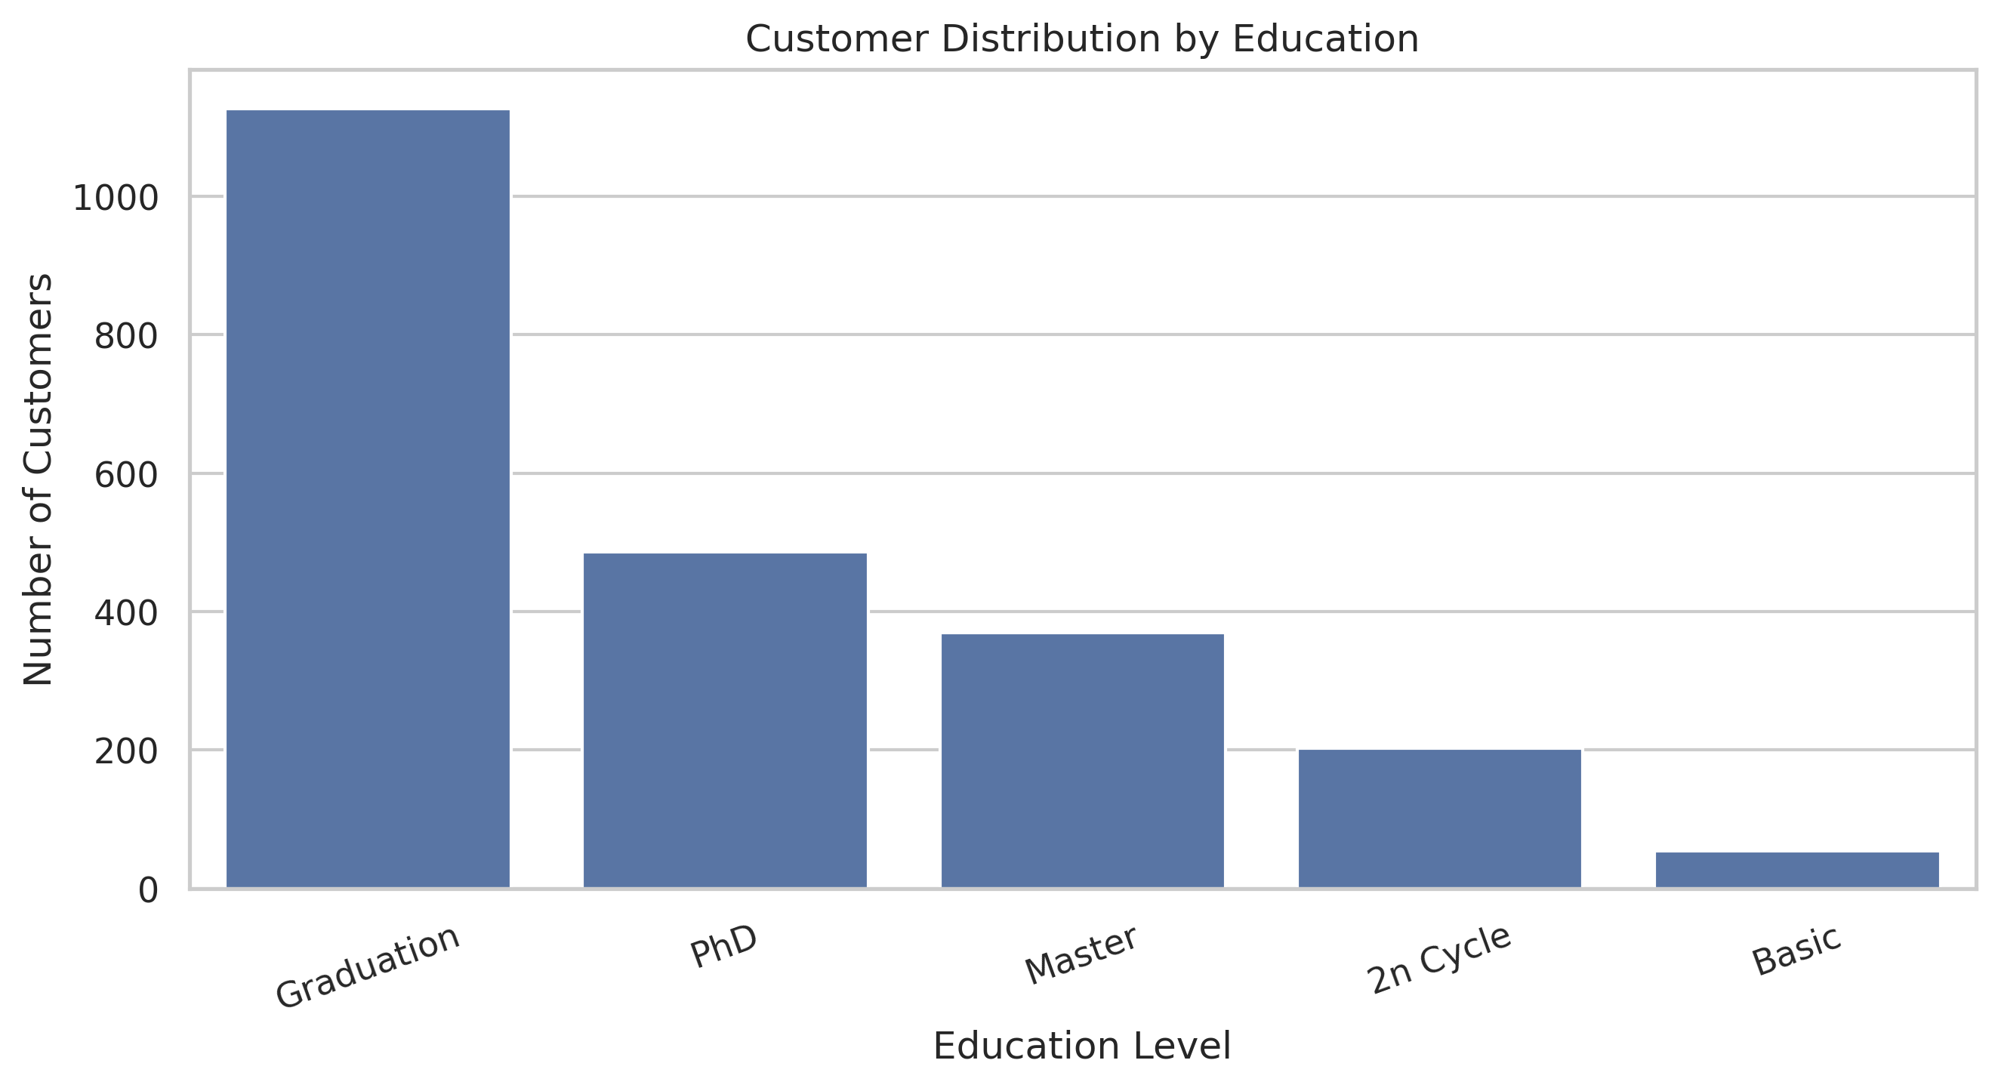
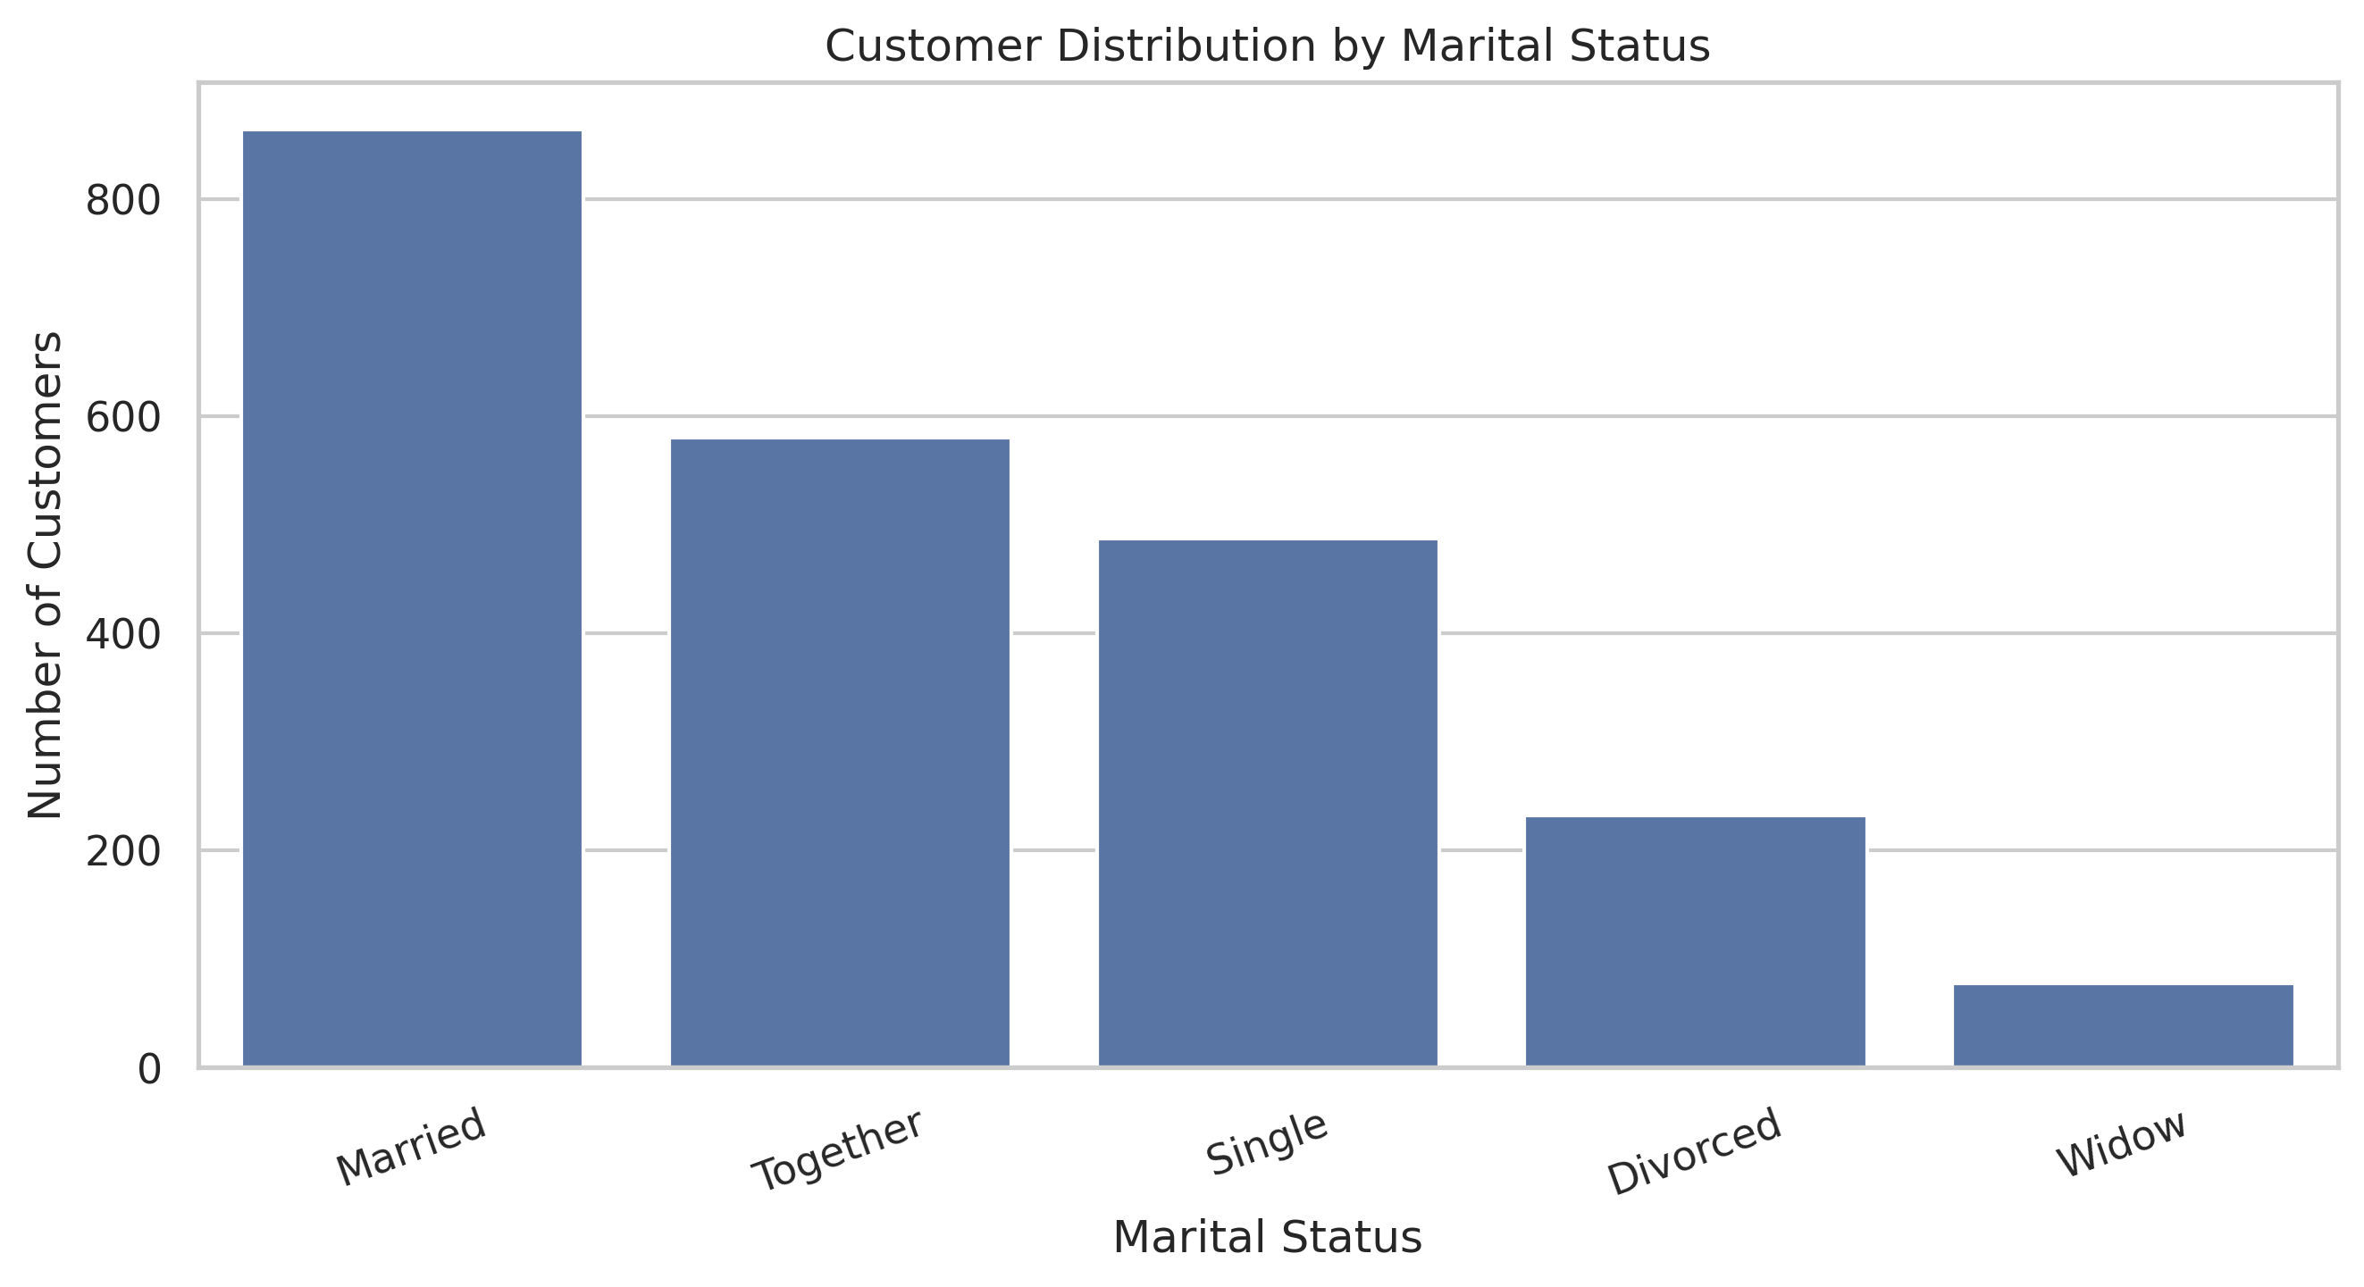
Customer profile
Mean age 55.10 (median 54). Mean income 52,243 (median 51,499). Mean 5.32 website visits per month. Graduation is the largest education group and Married the largest marital group.
Business meaning: Mainstream offers should fit a mid-life, middle-income core customer.

Slide 5
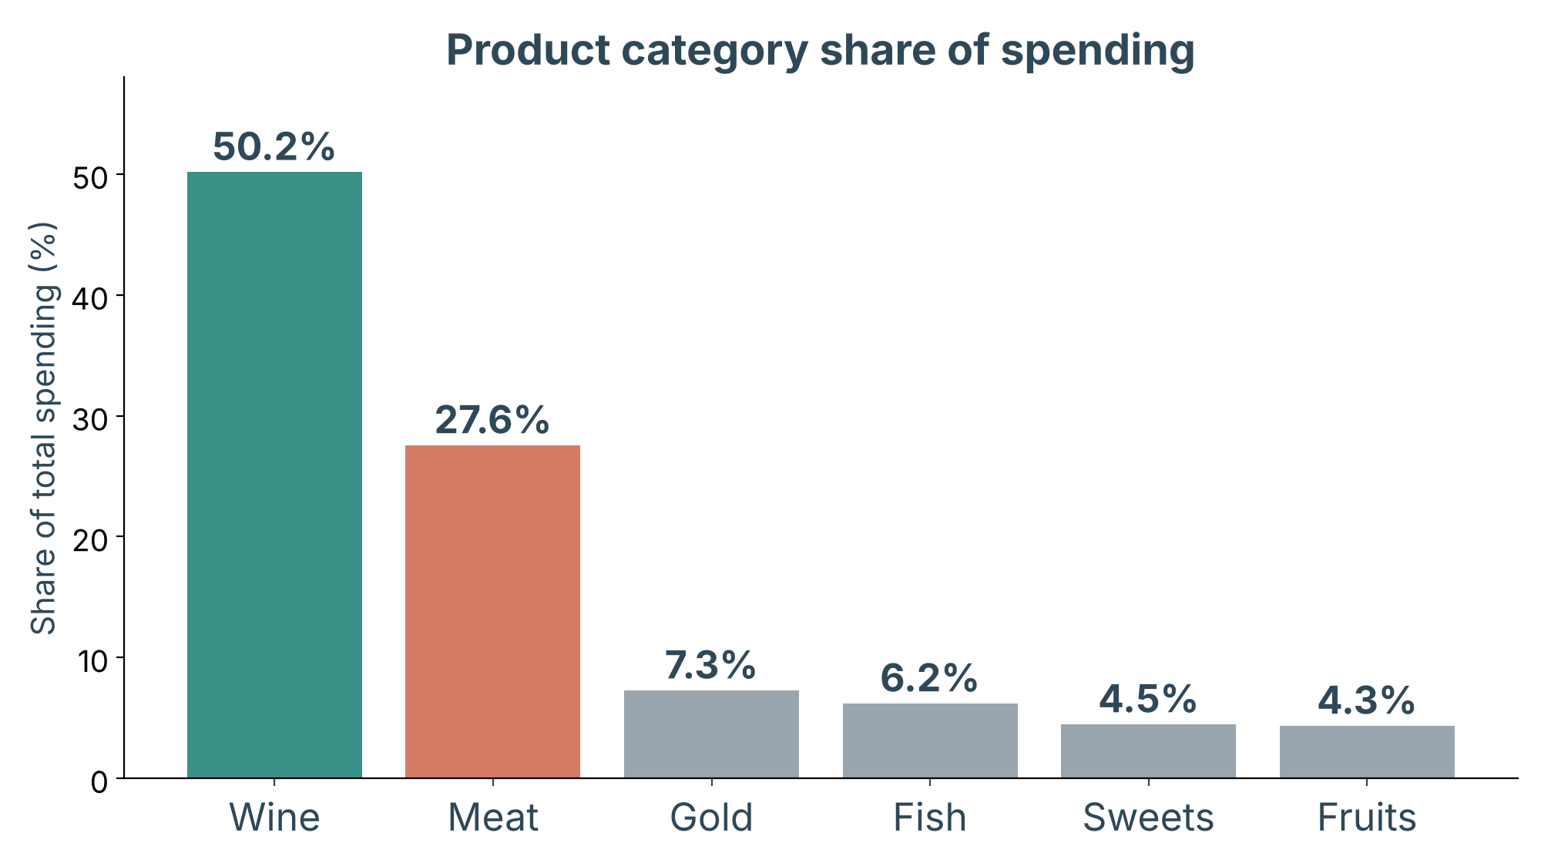
Wine and meat dominate spending
77.73%
of category spending is wine (50.17%) and meat (27.56%).
Average spend 605.80, median 396: a right-skewed distribution.
Business meaning: Start product promotions with wine and wine-and-meat bundles.

Slide 6
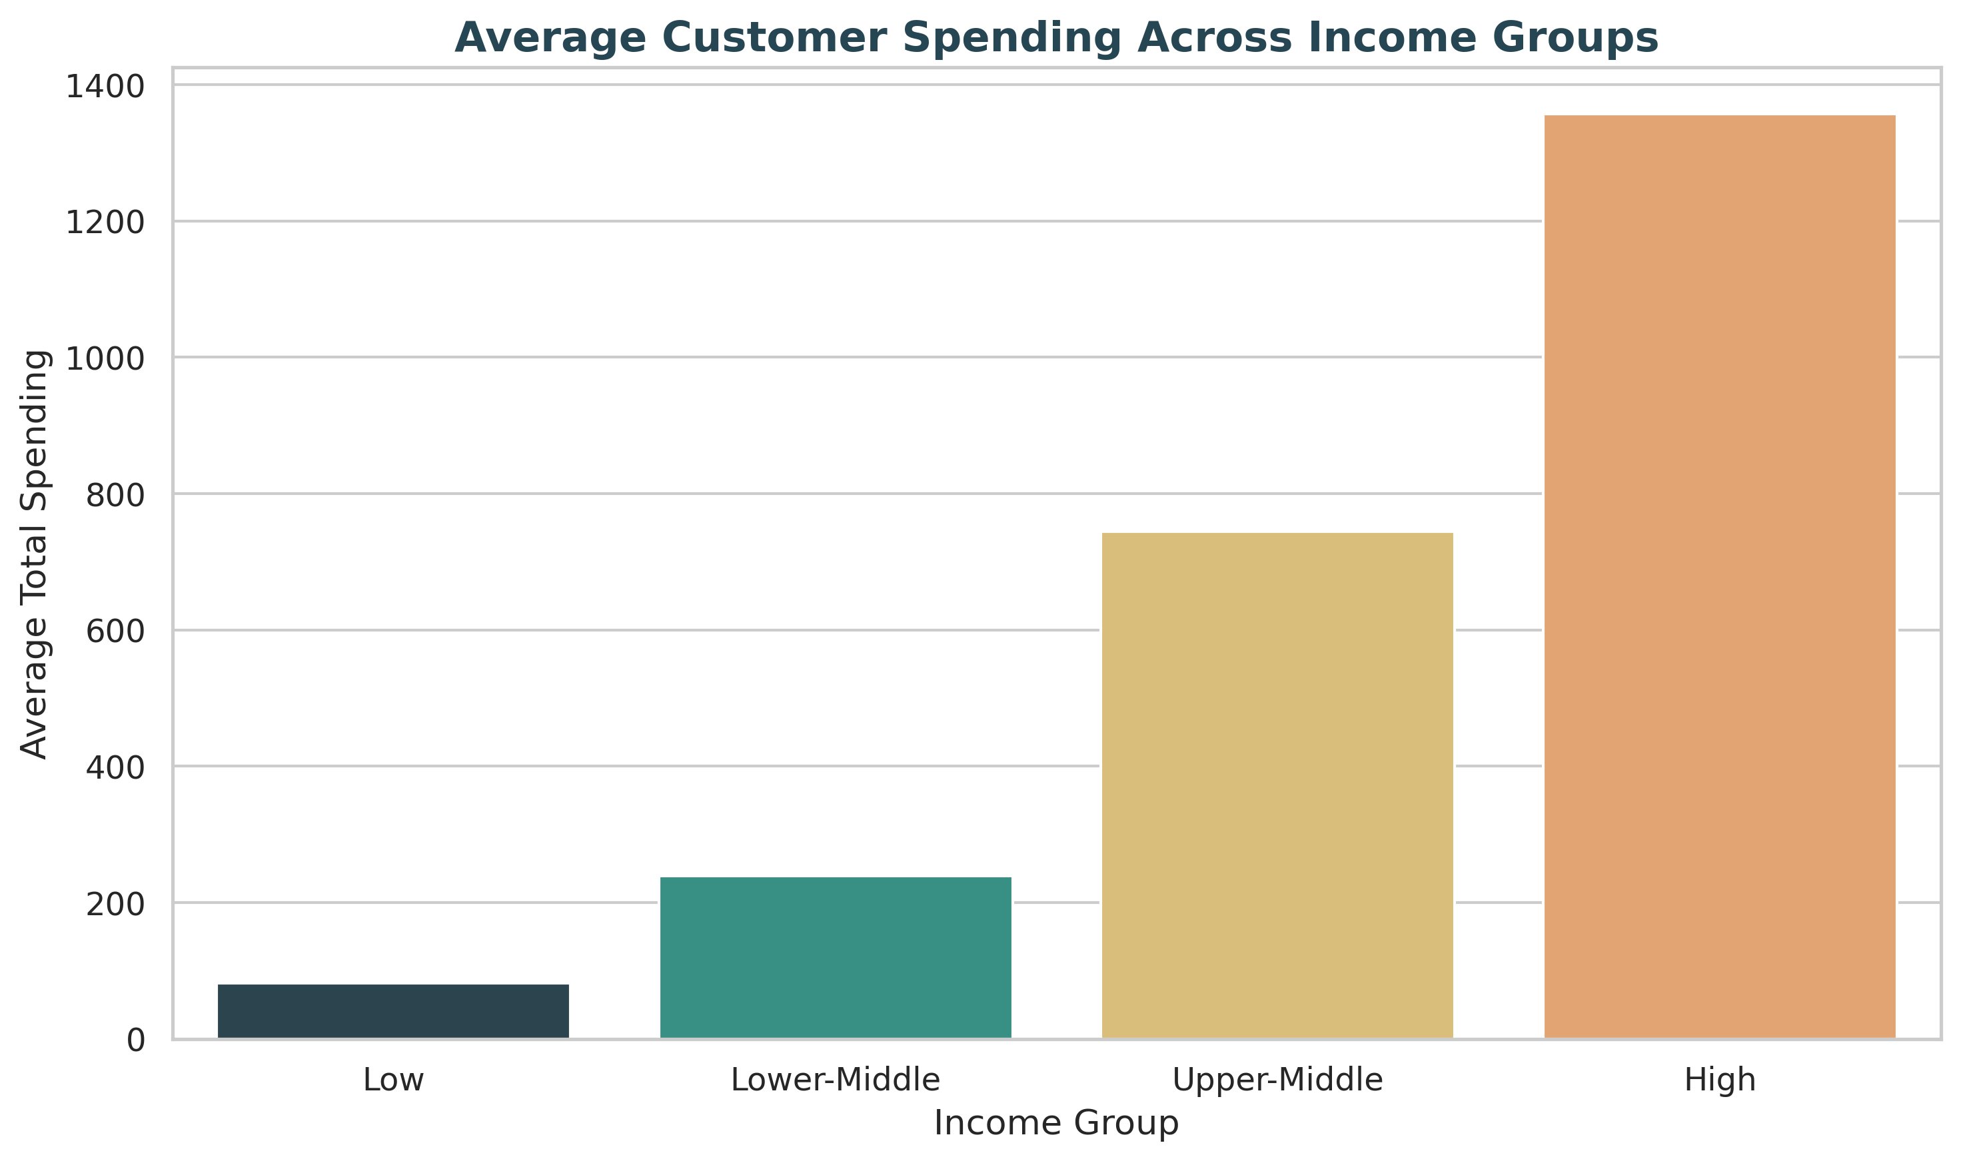
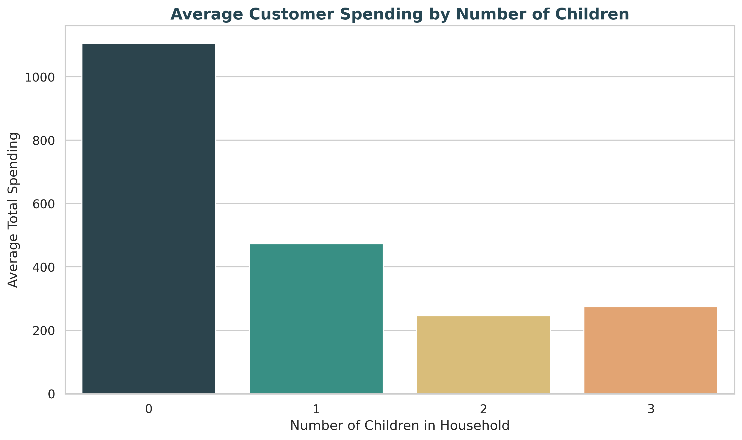
Spending by income and household
Average spend rises from 81.93 (low income) to 1,357.21 (high); correlation with income 0.66, an association only. Customers with no children average 1,106.03; the three-child group has only 53 customers.
Business meaning: Premium offers suit higher-income, child-free households.

Slide 7
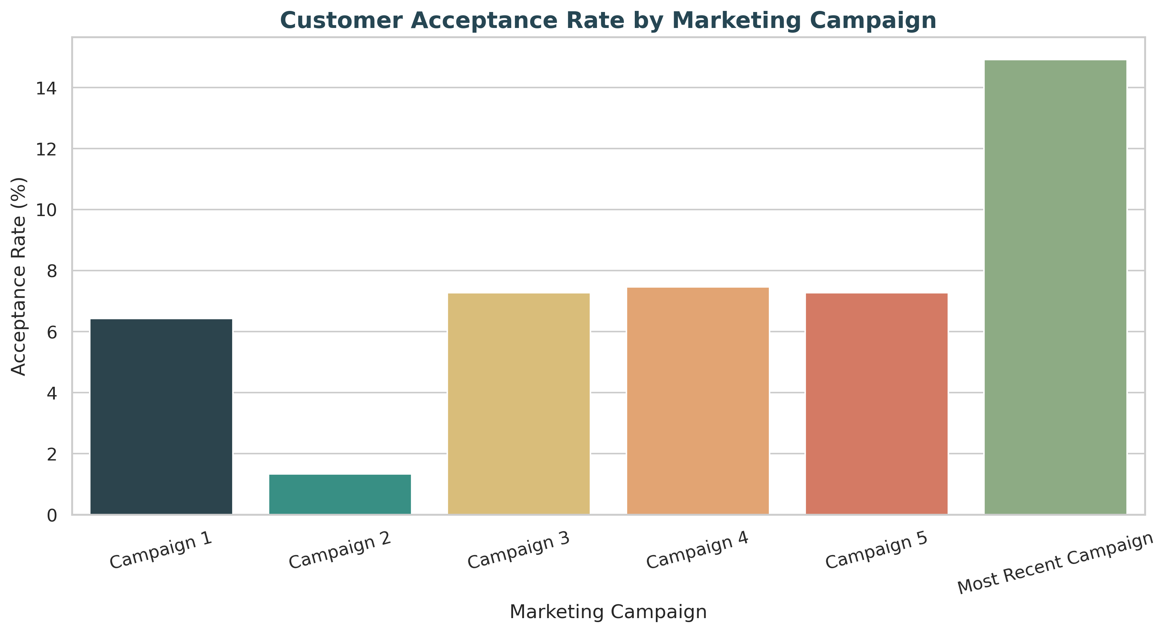
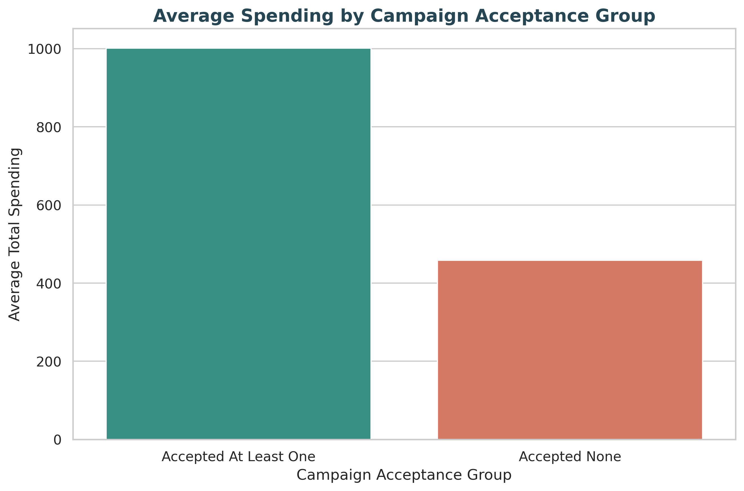
Campaign response
Most recent campaign 14.91% vs 7.46% for Campaign 4. 609 customers accepted at least one campaign (avg spend 1,001.33) vs 458.11 for the 1,631 who accepted none. Descriptive only; campaigns differ in design and audience.
Business meaning: Study the latest campaign and test similar approaches.

Slide 8
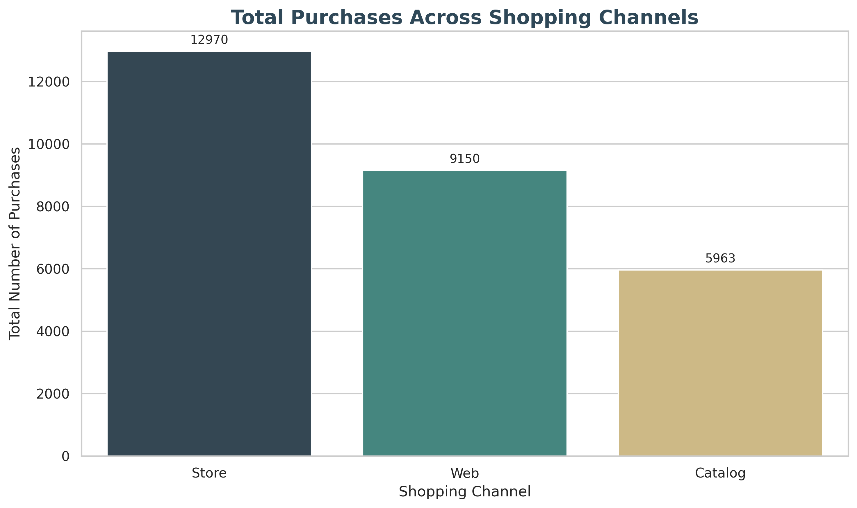
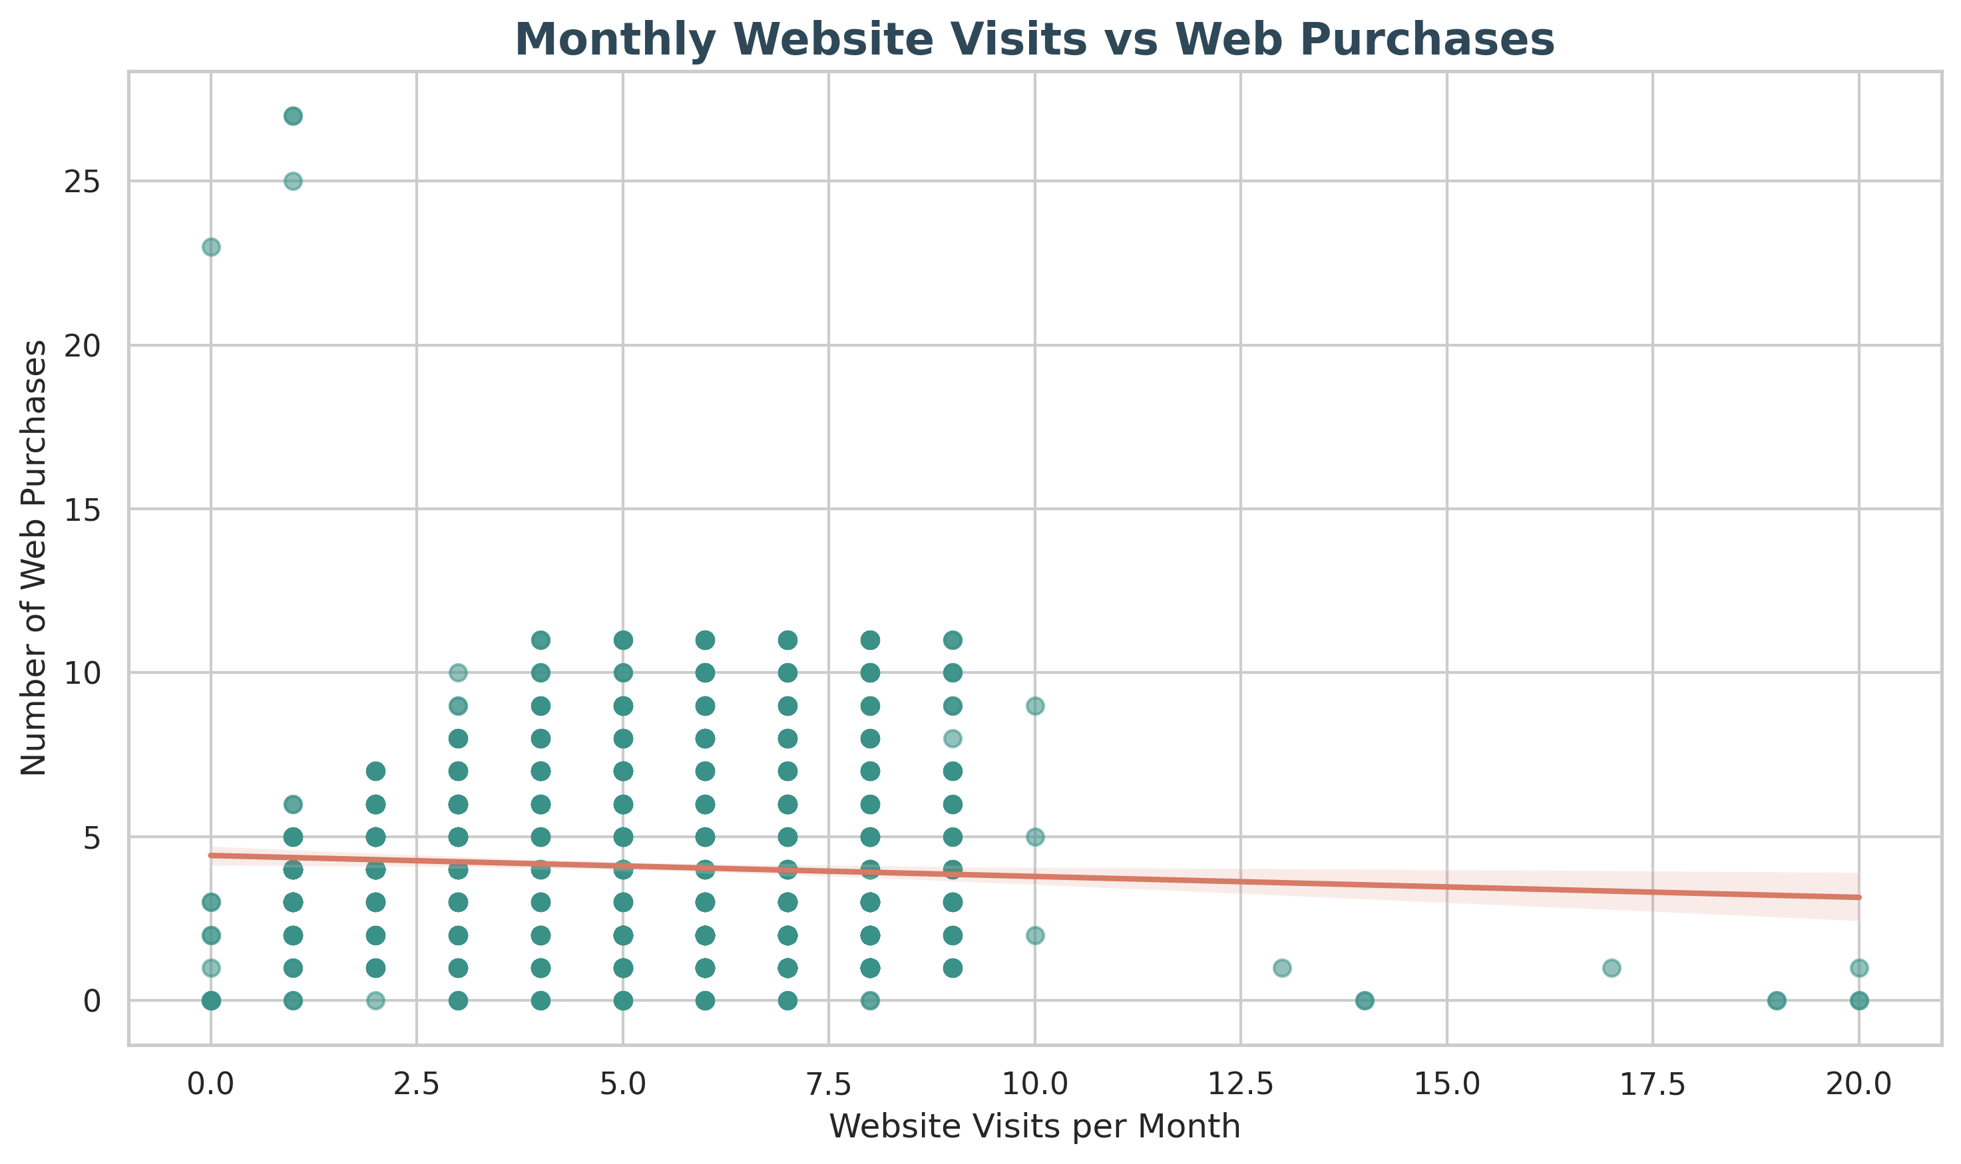
Shopping channels
Store 46.18%, web 32.58%, catalog 21.23% of purchases. Web visits and web purchases correlate at only −0.056.
Business meaning: Keep stores strong and fix online conversion; measure purchases per visit.

Slide 9
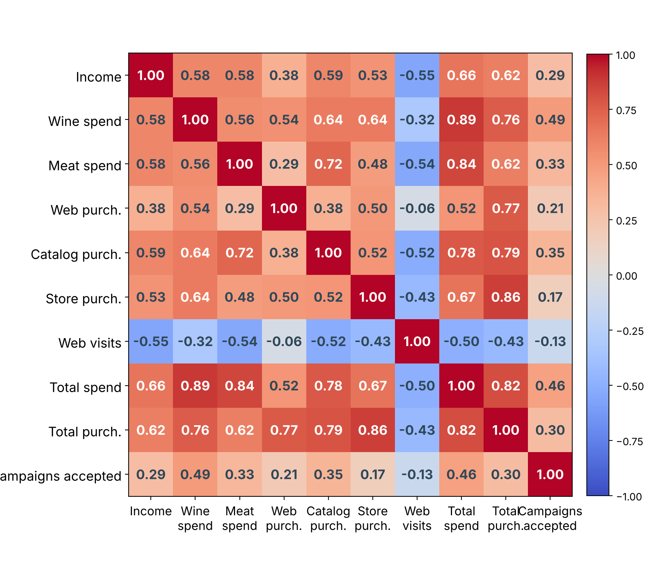
Key relationships
Income and total spending: 0.66
Spending and campaigns accepted: 0.46
Purchases and campaigns accepted: 0.30
Web visits and web purchases: −0.06
Total spending includes wine, so their 0.89 link is partly expected. Correlation is association, not causation.

Slide 10
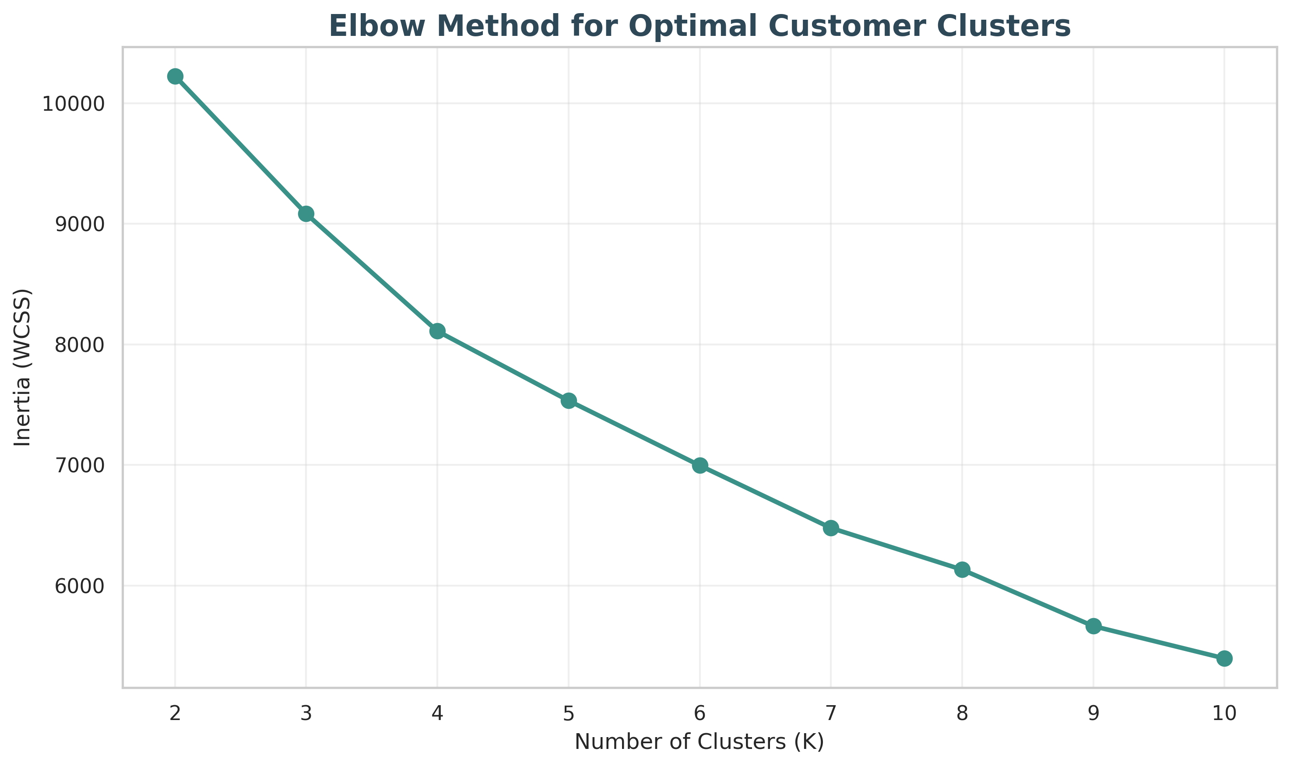
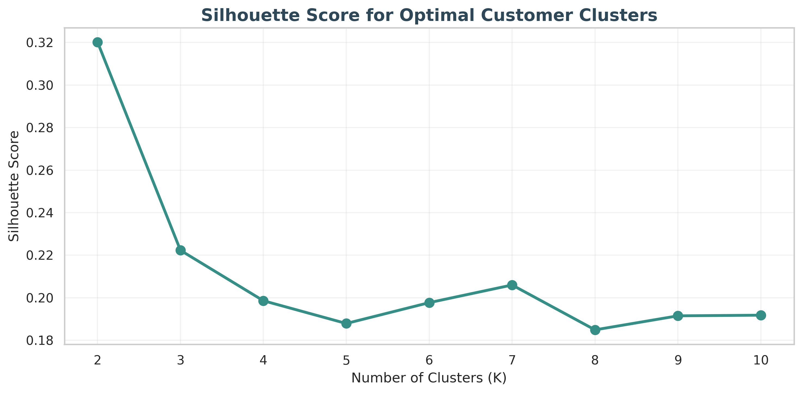
Segmentation method
K-Means on 7 scaled features (Income, TotalSpending, TotalPurchases, TotalChildren, Age, Recency, NumWebVisitsMonth) for 2,237 customers. Silhouette is highest at K = 2 (0.3202), which is moderate separation. The elbow falls gradually.
Business meaning: K = 2 is best among tested values, not the only useful grouping.

Slide 11
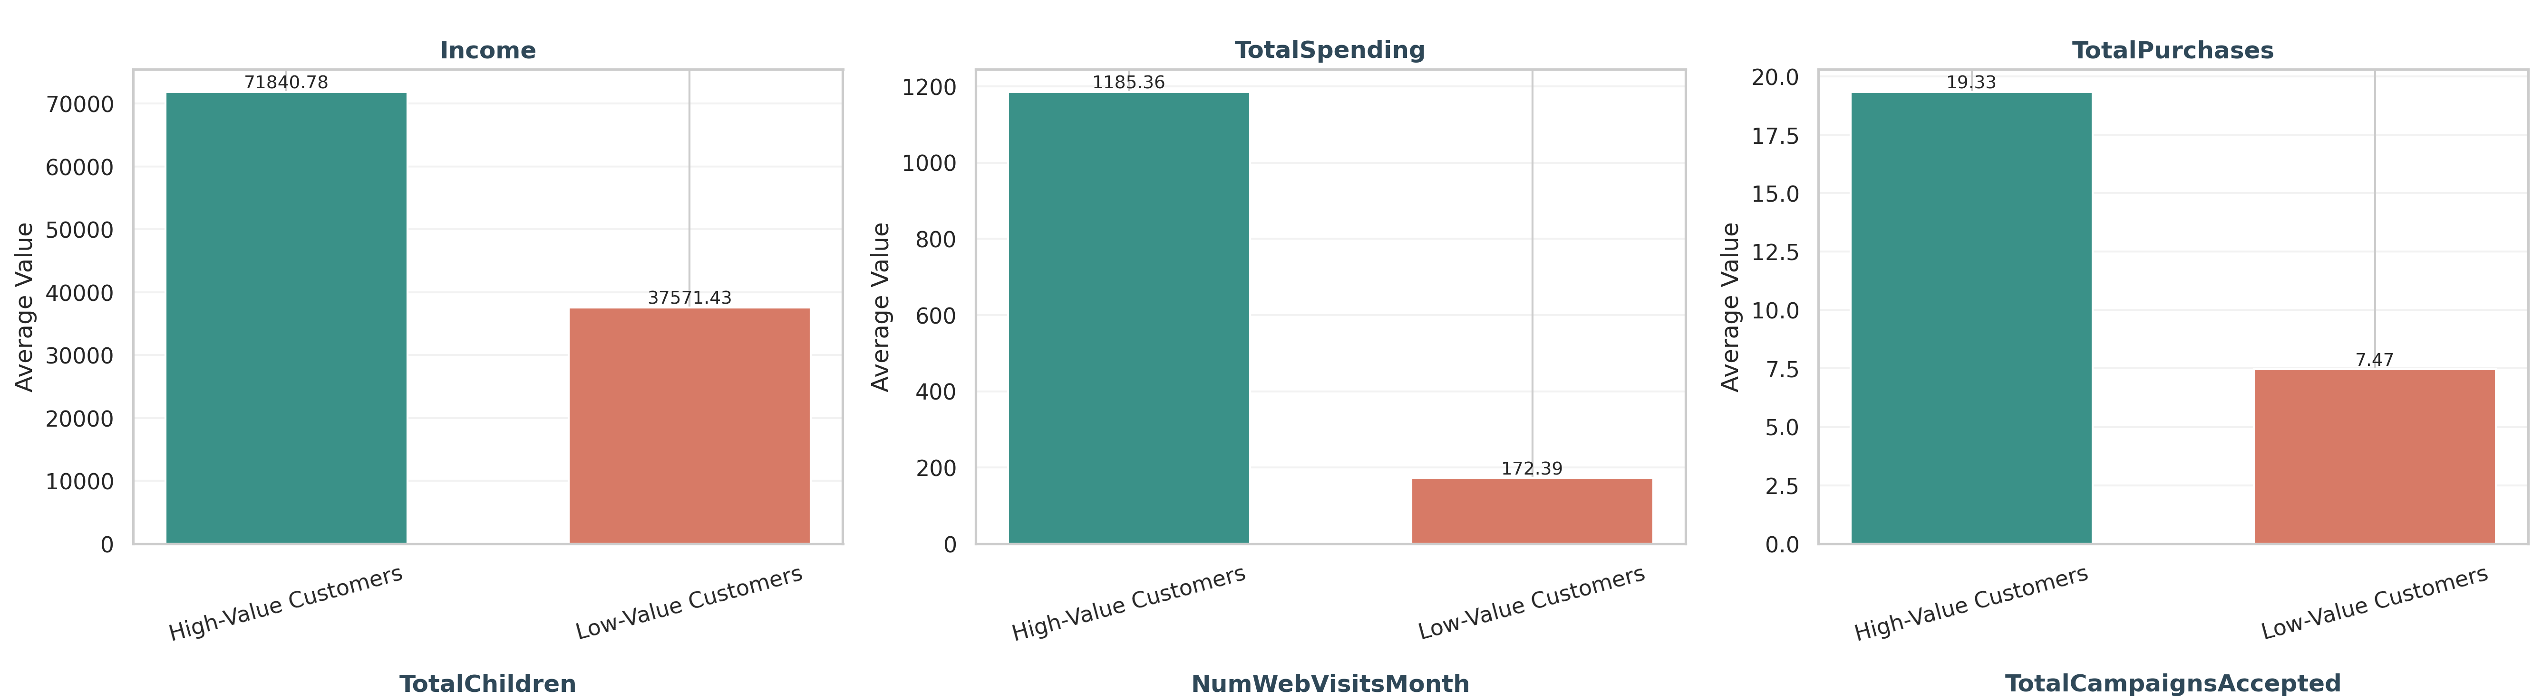
Two customer segments
High-Value: 957 (42.78%)
Low-Value: 1,280 (57.22%)
Web visits 3.67 per month
Web visits 6.55 per month
Business meaning: About 6.9 times the spend, yet fewer visits. Test conversion barriers for Low-Value customers.

Slide 12
Recommendations to test
Products
Retention
Wine is 50.17% of spend. Test wine promotions and wine-and-meat bundles.
High-Value customers average 0.76 acceptances. Test loyalty rewards; for Low-Value customers, test intro deals.
Campaigns
Online and premium
The latest campaign hit 14.91%. Study it and repeat similar approaches.
Visits do not predict purchases (−0.056). Improve navigation and checkout, and test premium picks for high incomes.
These are hypotheses. Measure conversion, order value, repeat purchases and retention with A/B tests.

Slide 13
Conclusion and limitations
Wine and meat lead spending, stores lead channels, and K-Means found two segments with very different income, spending and purchasing.
Limitations
Next steps
Moderate silhouette (0.3202)
Income outlier kept
916 dates unresolved
Correlation is not causation
Check cluster stability without the outlier
Run A/B tests on offers
Track conversion and retention
Thank you. Questions?

